Slide 1
COMPUTER ARCHITECTURE Lect1

Slide 2
OVERVIEW
In the modern world of electronics, the term Digital is generally associated with a computer because the term Digital is derived from the way computers perform operation, by counting digits.
For many years, the application of digital electronics was only in the computer system.
But now-a-days, digital electronics is used in many other applications.

Slide 3
OVERVIEW(cont.)
Following are some of the examples in which Digital electronics is heavily used.
Industrial process control
Military system
Television
Communication system
Medical equipment
Radar
Navigation .

Slide 4
OVERVIEW(cont.)
Signal
Signal can be defined as a physical quantity, which contains some information. It is a function of one or more than one independent variables. Signals are of two types.
Analog Signal
Digital Signal

Slide 5
OVERVIEW(cont.)
Analog Signal
An analog signal is defined as the signal having continuous values. Analog signal can have infinite number of different values. In real world scenario, most of the things observed in nature are analog. Examples of the analog signals are following.
Temperature
Pressure
Distance
Sound
Voltage
Current

Slide 6
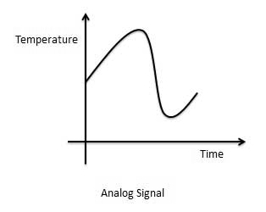
Graphical Representation of Analog Signal (Temperature)

Slide 7
The circuits that process the analog signals are called as analog circuits or system. Examples of the analog system are following.
Filter
Amplifiers
Television receiver
Motor speed controller

Slide 8
Disadvantage of Analog Systems
Less accuracy
Less versatility
More noise effect
More distortion
More effect of weather

Slide 9
Digital Signal
A digital signal is defined as the signal which has only a finite number of distinct values.
Digital signals are not continuous signals. In the digital electronic calculator, the input is given with the help of switches.
This input is converted into electrical signal which have two discrete values or levels.
One of these may be called low level and another is called high level. The signal will always be one of the two levels.

Slide 10
This type of signal is called digital signal.
Examples of the digital signal are following.
Binary Signal
Octal Signal
Hexadecimal Signal

Slide 11
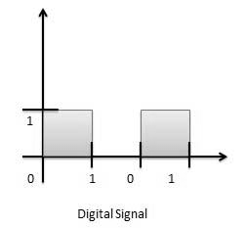
Graphical Representation of Digital Signal (Binary)

Slide 12
The circuits that process the digital signals are called digital systems or digital circuits. Examples of the digital systems are following.
Registers
Flip-flop
Counters
Microprocessors

Slide 13
Advantage of Digital Systems
More accuracy
More versatility
Less distortion
Easy communicate
Possible storage of information

Slide 14
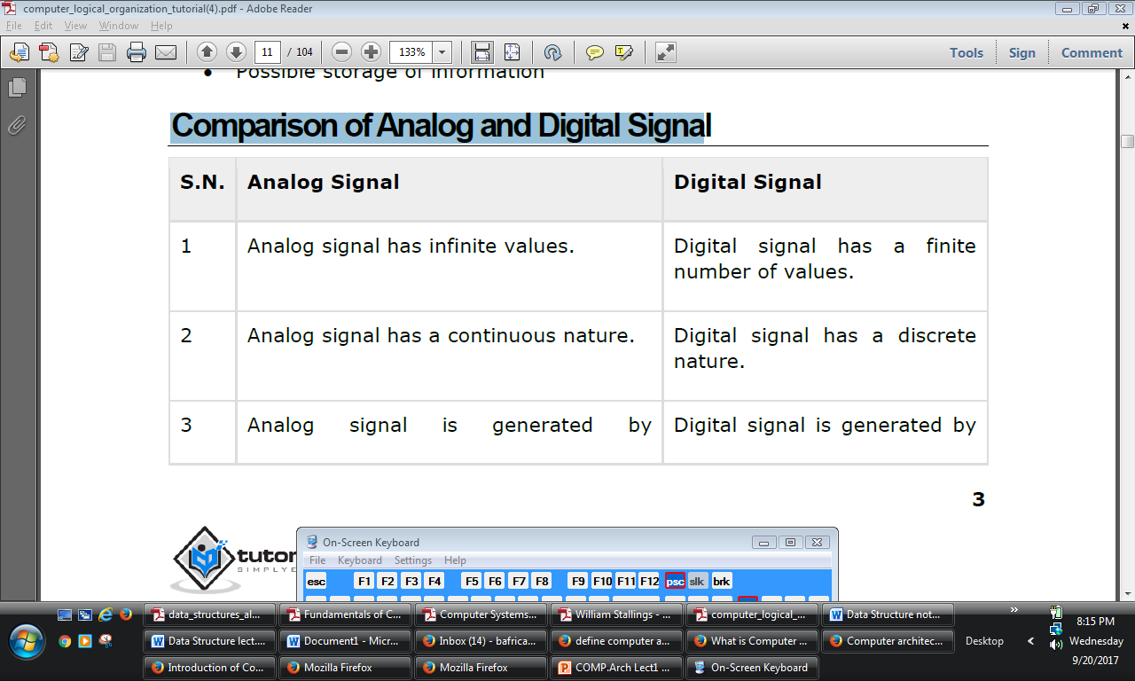
Comparison of Analog and Digital Signal

Slide 15
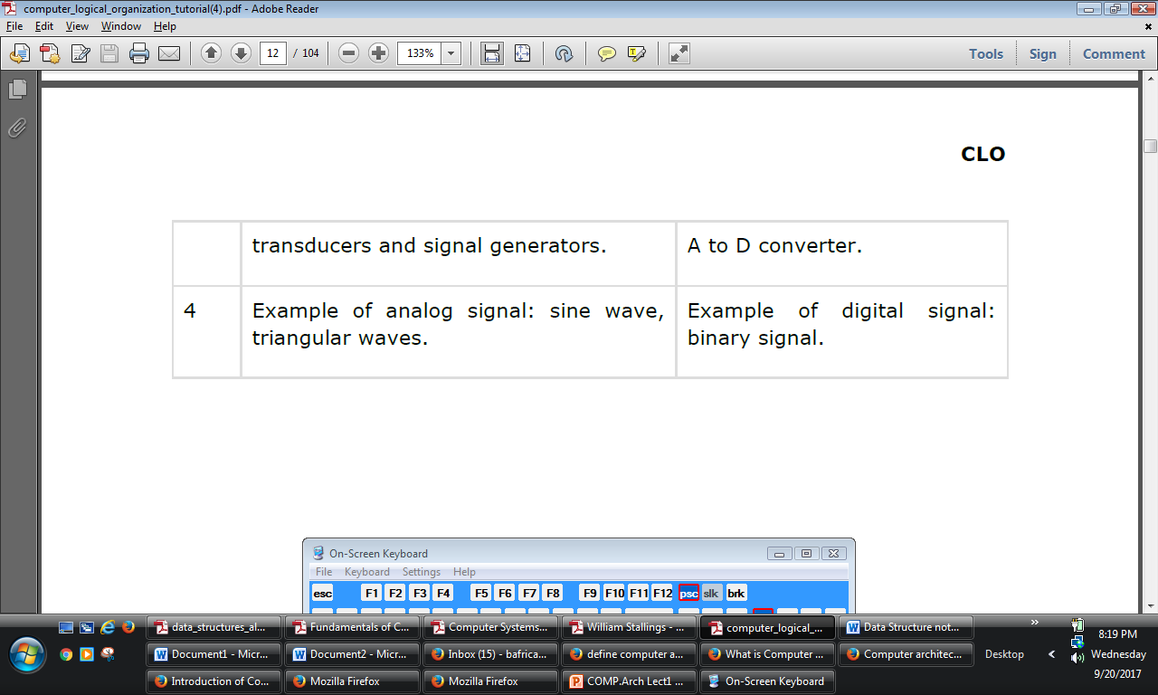
Comparison of Analog and Digital Signal

